Slide 1

dfm_tools
A Python package for D-FlowFM input and output
Jelmer Veenstra

Slide 2


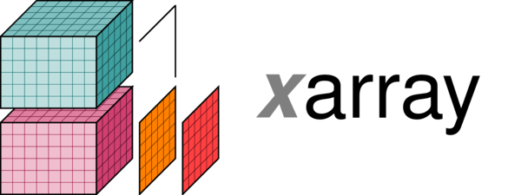




dfm_tools: the concept
What:
a Python package for pre- and postprocessing D-FlowFM input and output files
contains convenience functions built on top of other packages like xarray, xugrid, hydrolib-core and many more
Why:
sharing of workflows among users (colleagues/external)
no need to reinvent the wheel
developments driven by projects like hydrolib-core, MassBay, FutureMares, TCOMS
Where:
code on github: https://github.com/Deltares/dfm_tools
installable via pip
jupyter notebooks and binder with example code

Slide 3
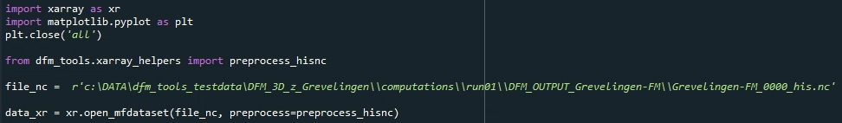
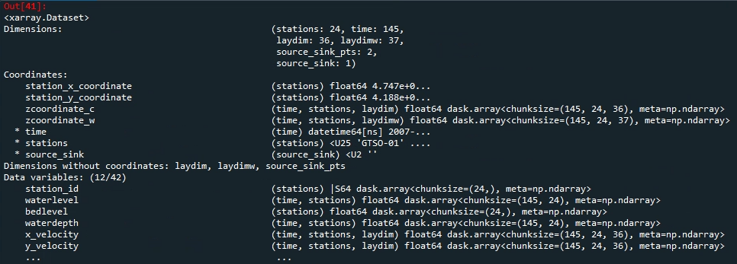
xarray: io of netcdf files
lazy loading of netcdf files with knowledge of the entire structure
easy indexing over all dimensions with .isel() and .sel()
preprocess_his() enables indexing via station names (and other labels)

Slide 4
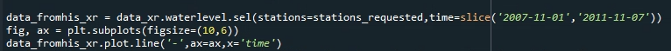
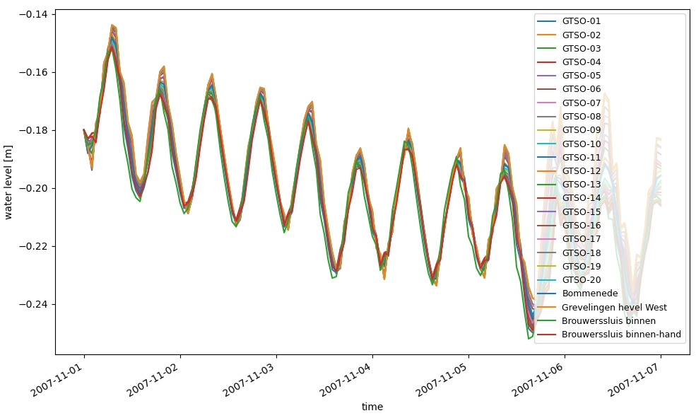
xarray: io of netcdf files
easy indexing (subsetting)
easy and complete plotting
.../tests/examples/postprocess_hisnc.py

Slide 5
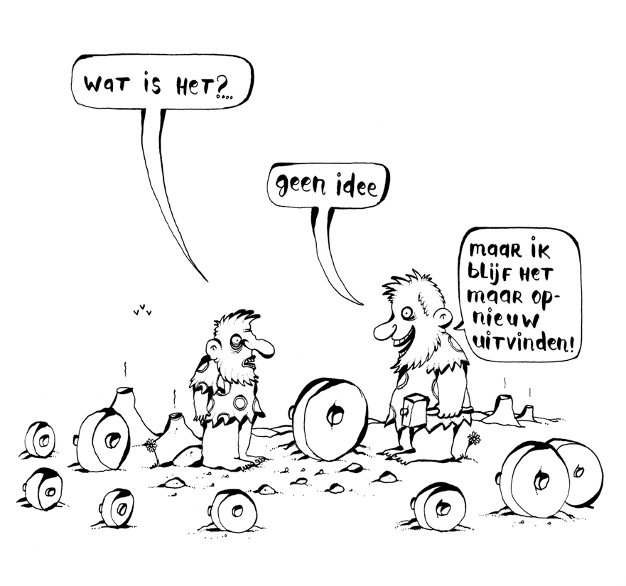
HYDROLIB: io of D-FlowFM input files
Core scripts & tools for interaction with D-FlowFM:
reading/writing of (almost all) D-FlowFM input files (mdu, ext, bc, pli, etc)
full functionalities: https://deltares.github.io/HYDROLIB-core/0.3.1/topics/dhydro_support/
supported, documented, maintained
available on github: https://github.com/Deltares/HYDROLIB-core
users do not need to re-invent the wheel about “basic stuff/file formats”, focus on the analysis itself

Slide 6
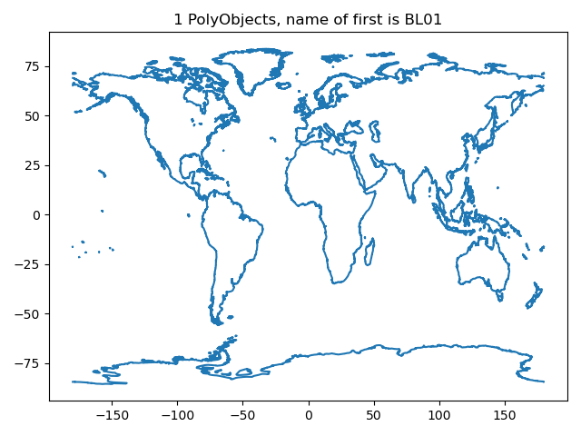
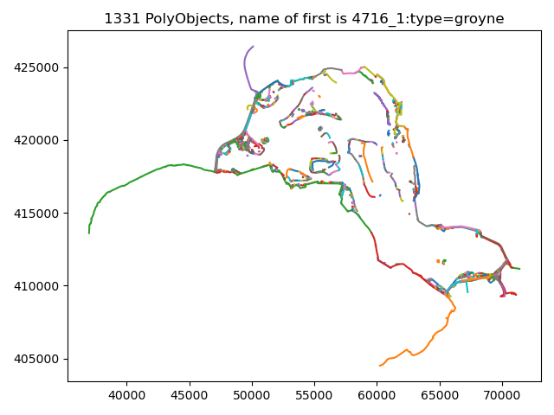
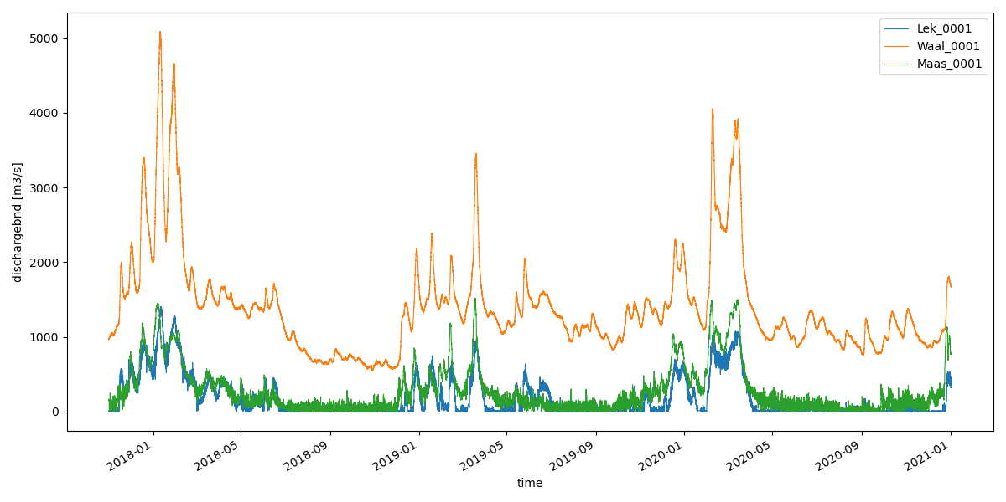
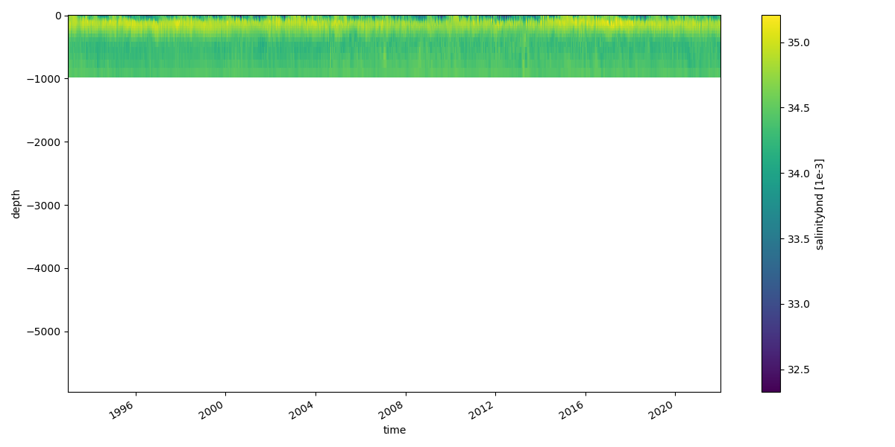
Examples: reading+plotting of D-FlowFM input files
hydrolib for reading files
conversion to xarray/pandas dataset with dfm_tools
figures: pli/pliz/ldb/tek and bc files
.../tests/examples/preprocess_hydrolib_readbc.py
.../tests/examples/preprocess_hydrolib_readwritepol.py

Slide 7
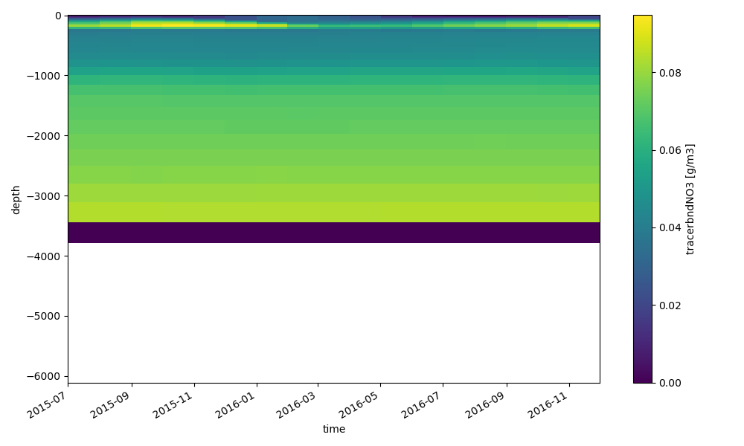
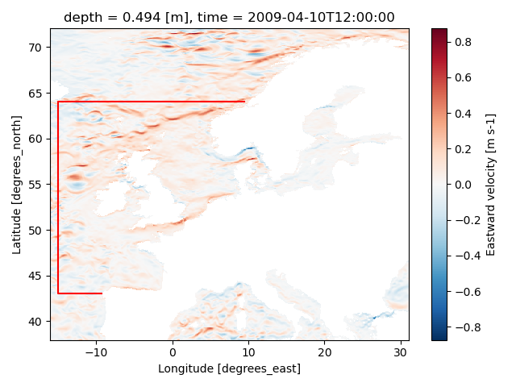
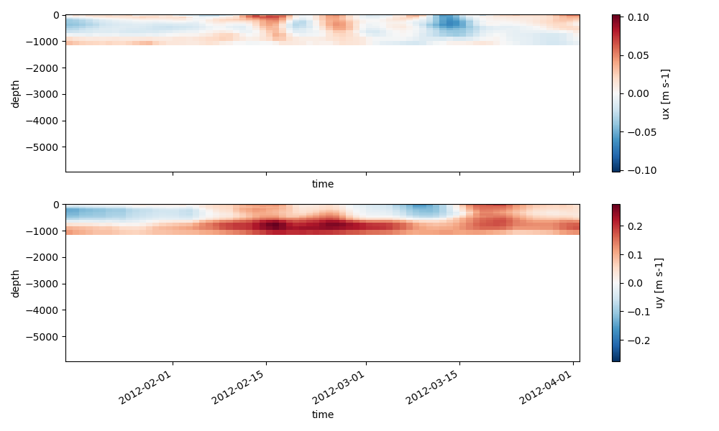
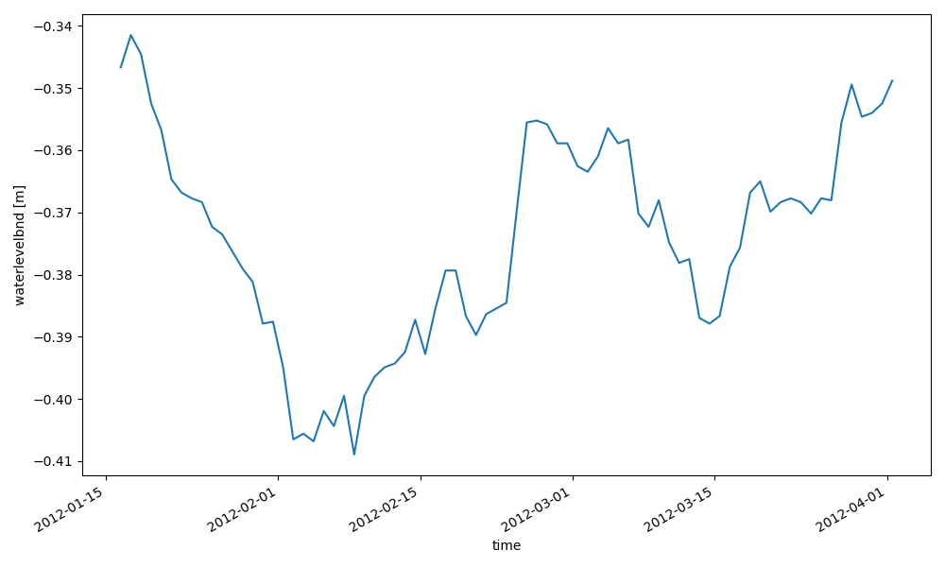
Examples: interpolate oceanmodel to bc
xarray for reading netcdf data and .interp() to polyline points
hydrolib for reading pli and writing bc/ext files
.../tests/examples/preprocess_interpolate_nc_to_bc.py

Slide 8
Application for regional models
Manually defined model boundaries, used for:
Grid cut-out of GTSM (currently manual)
Download of ERA5 and CMEMS field
.../tests/examples/download_meteodata_oceandata.py
Generation of (2D) open boundary forcing from FES2014 (tidal constituents)
.../tests/examples/preprocess_interpolate_nc_to_bc.py
Generation of (3D) open boundary forcing from CMEMS (salinity, temperature and sealevel anomaly)
.../tests/examples/preprocess_interpolate_nc_to_bc.py
Generation of 3D initial fields from CMEMS (salinity and temperature)
.../tests/examples/preprocess_ini_cmems_to_nc.py
Generation of meteorological forcing fields
.../tests/examples/preprocess_meteo_mergenetCDFtime_xarray.py
The dfm_tools enables the quick set-up of the basis of a 3D model

Slide 9
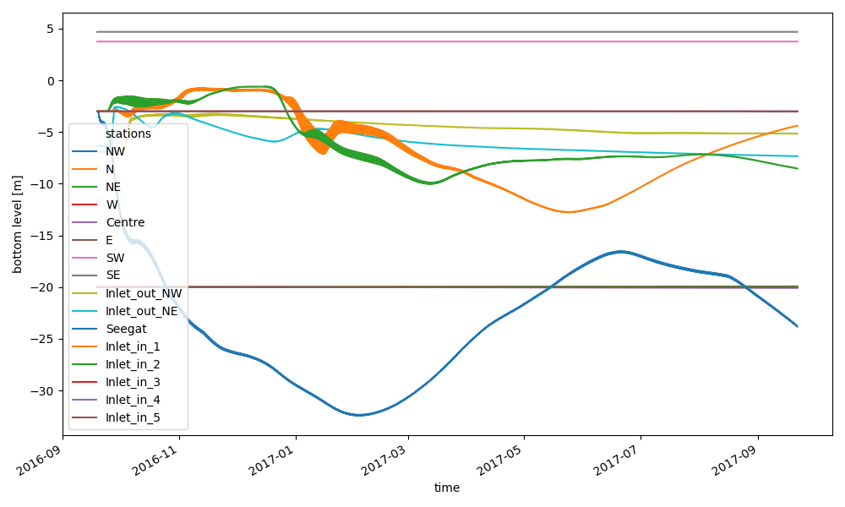
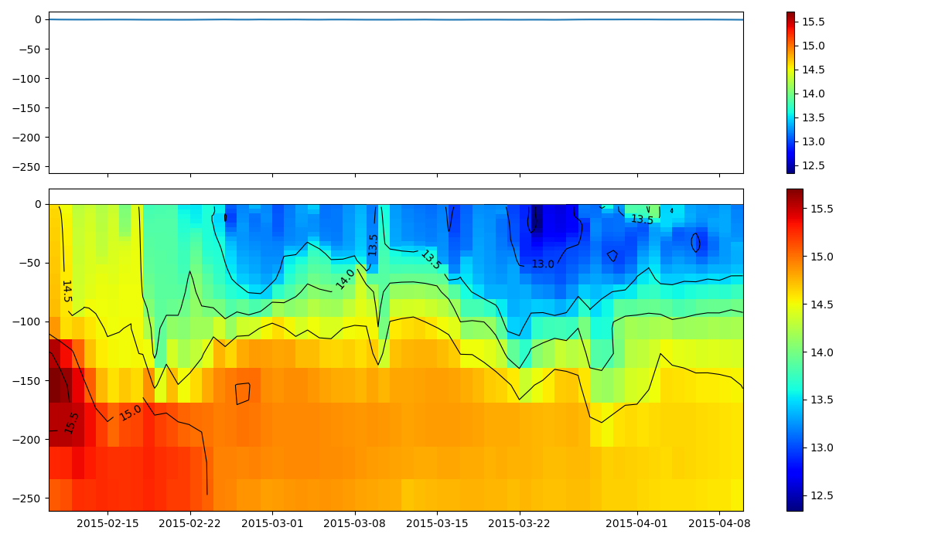
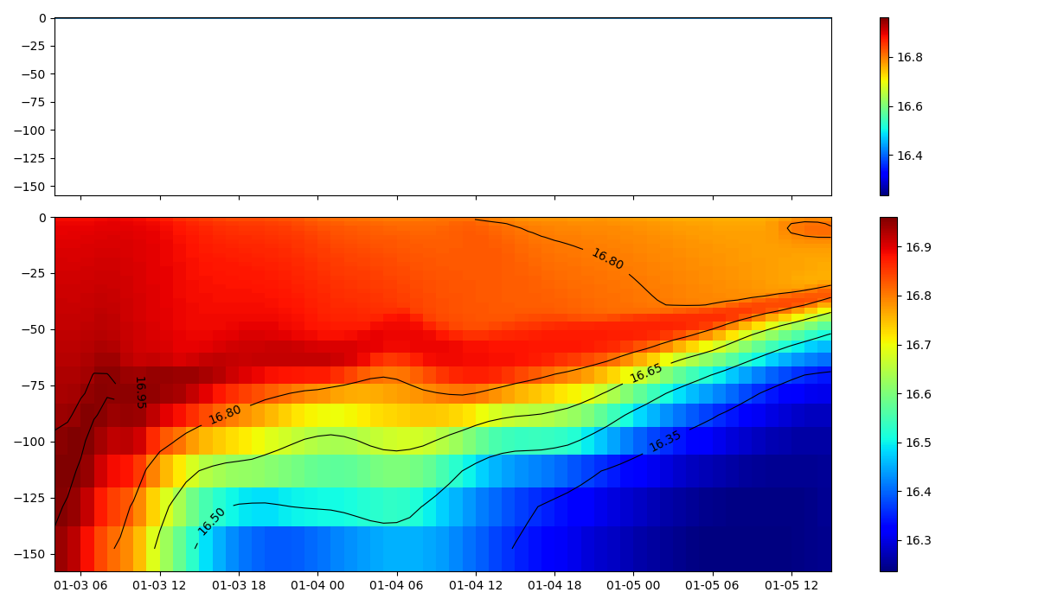
Examples: read+plot hisfile
xarray for reading hisfile (D-FlowFM and sfincs)
easy retrieval of lists of stations, cross_sections, general structures, etc thanks to preprocess_hisnc()
selection of data over dimensions: time, depth, stations, cross_sections, structures, etc
zt-plot (timeseries of one point with depth dim)
.../tests/examples/postprocess_hisnc.py
coming up:
interpolation
nesting

Slide 10
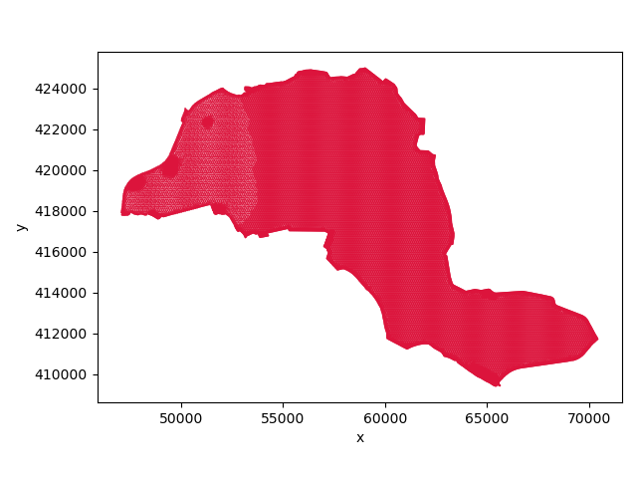
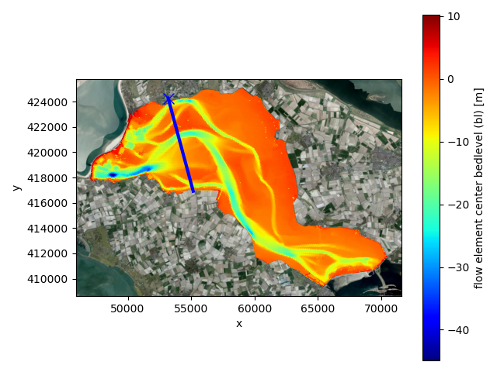
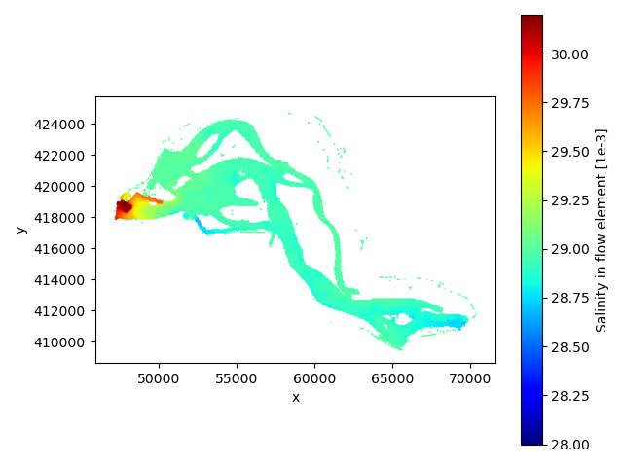
Examples: read+plot mapfiles
xarray/xugrid for reading D-FlowFM (unstructured) map/fou/rst/net files
supports partitions (handling of ghost cells)
select data based on variable and dimensions (time/layer/etc)
satellite backgrounds with contextily
3D slicing (horizontal/vertical): next slides

Slide 11
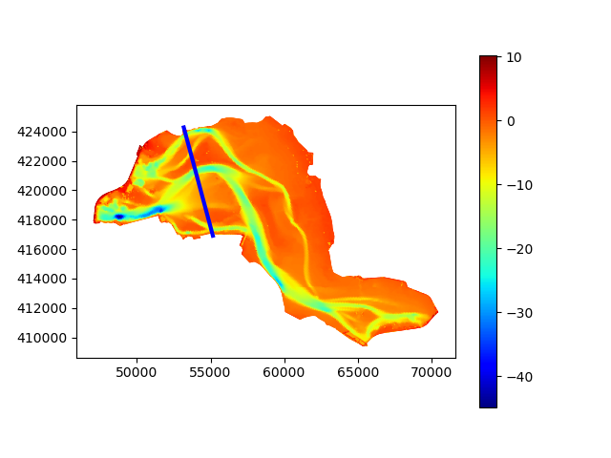
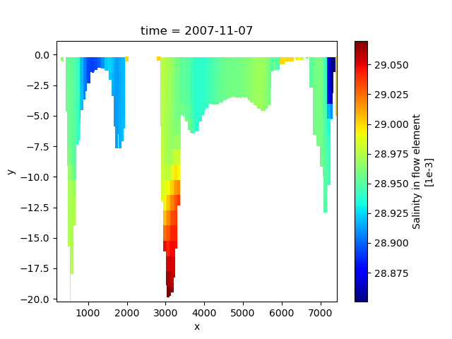
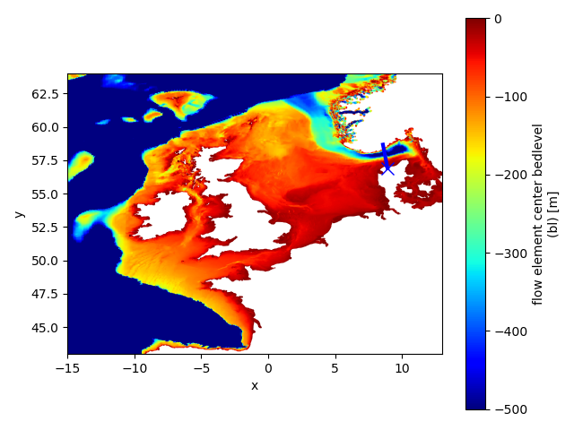
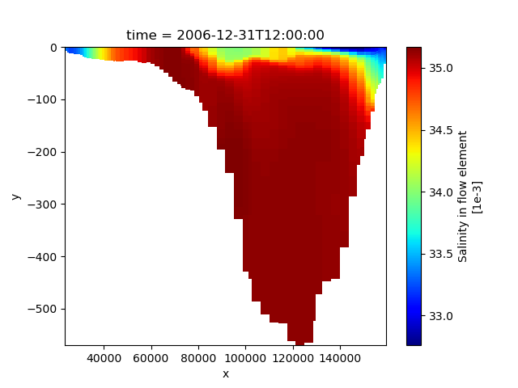
Examples: slice trough 3D partitioned FM map data
given a polyline (blue)
slice trough 3D partitioned FM map data
returns an xugrid DataArray so plotting is easy
also possible to select values based on depth w.r.t. z0/wl/bl

Slide 12
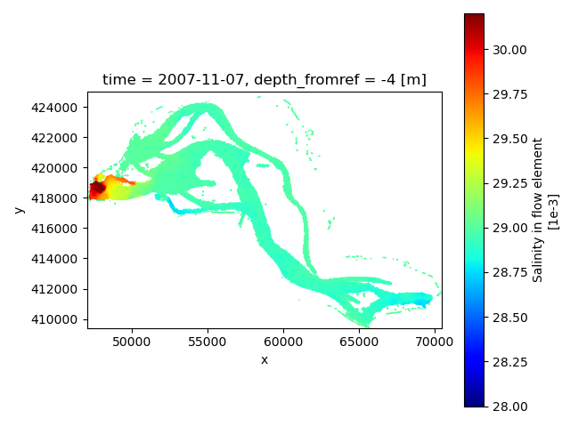
Examples: slice trough 3D partitioned FM map data
given a depth w.r.t. z0, waterlevel, bedlevel
slice trough 3D partitioned FM map data
multiple depths supported
support for sigma, z and zsigma layers
also implemented for hisfiles

Slide 13
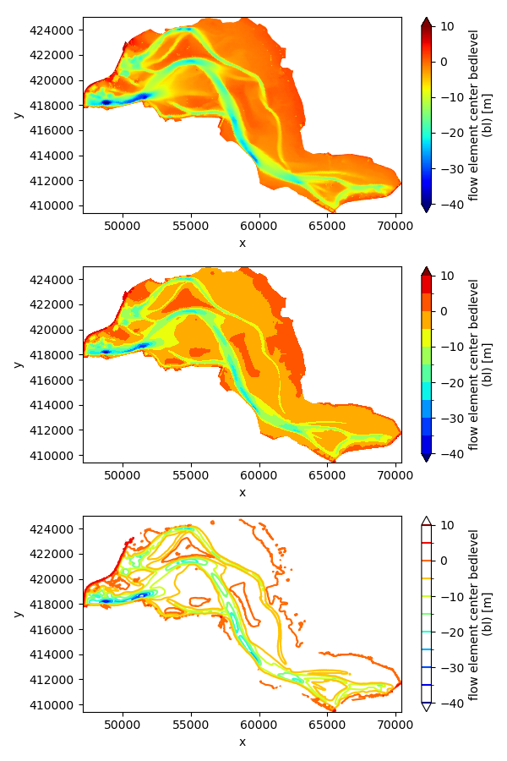
Examples: various plotting options
Easy to create fancier plots like contourf or contour
backened by xugrid and xarray
More examples in the xugrid docs

Slide 14
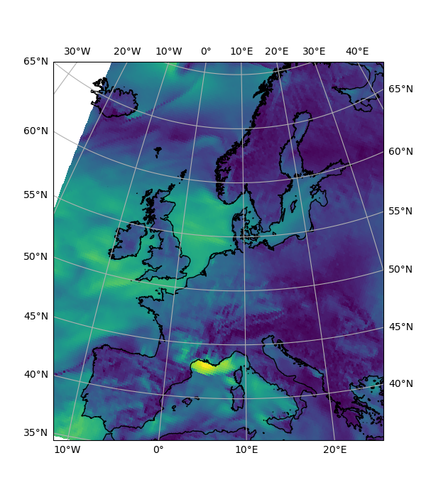
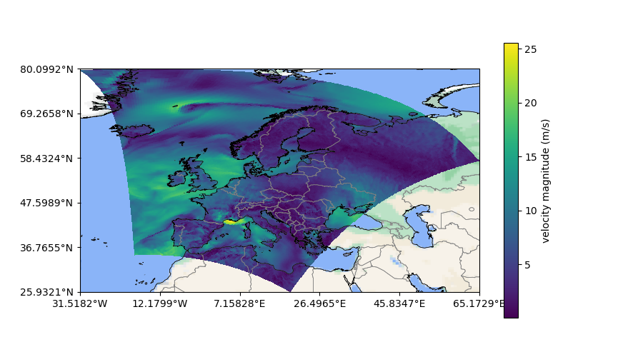
Examples: cartopy basemaps and coastlines/borders
support for almost any epsg

Slide 15
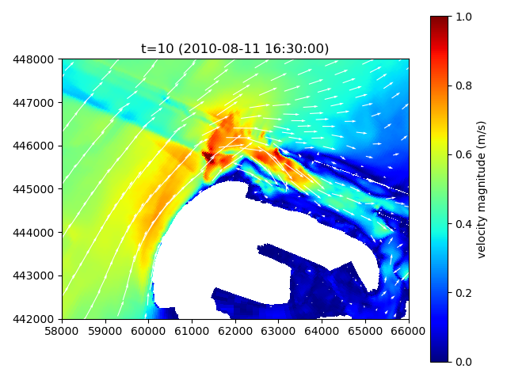
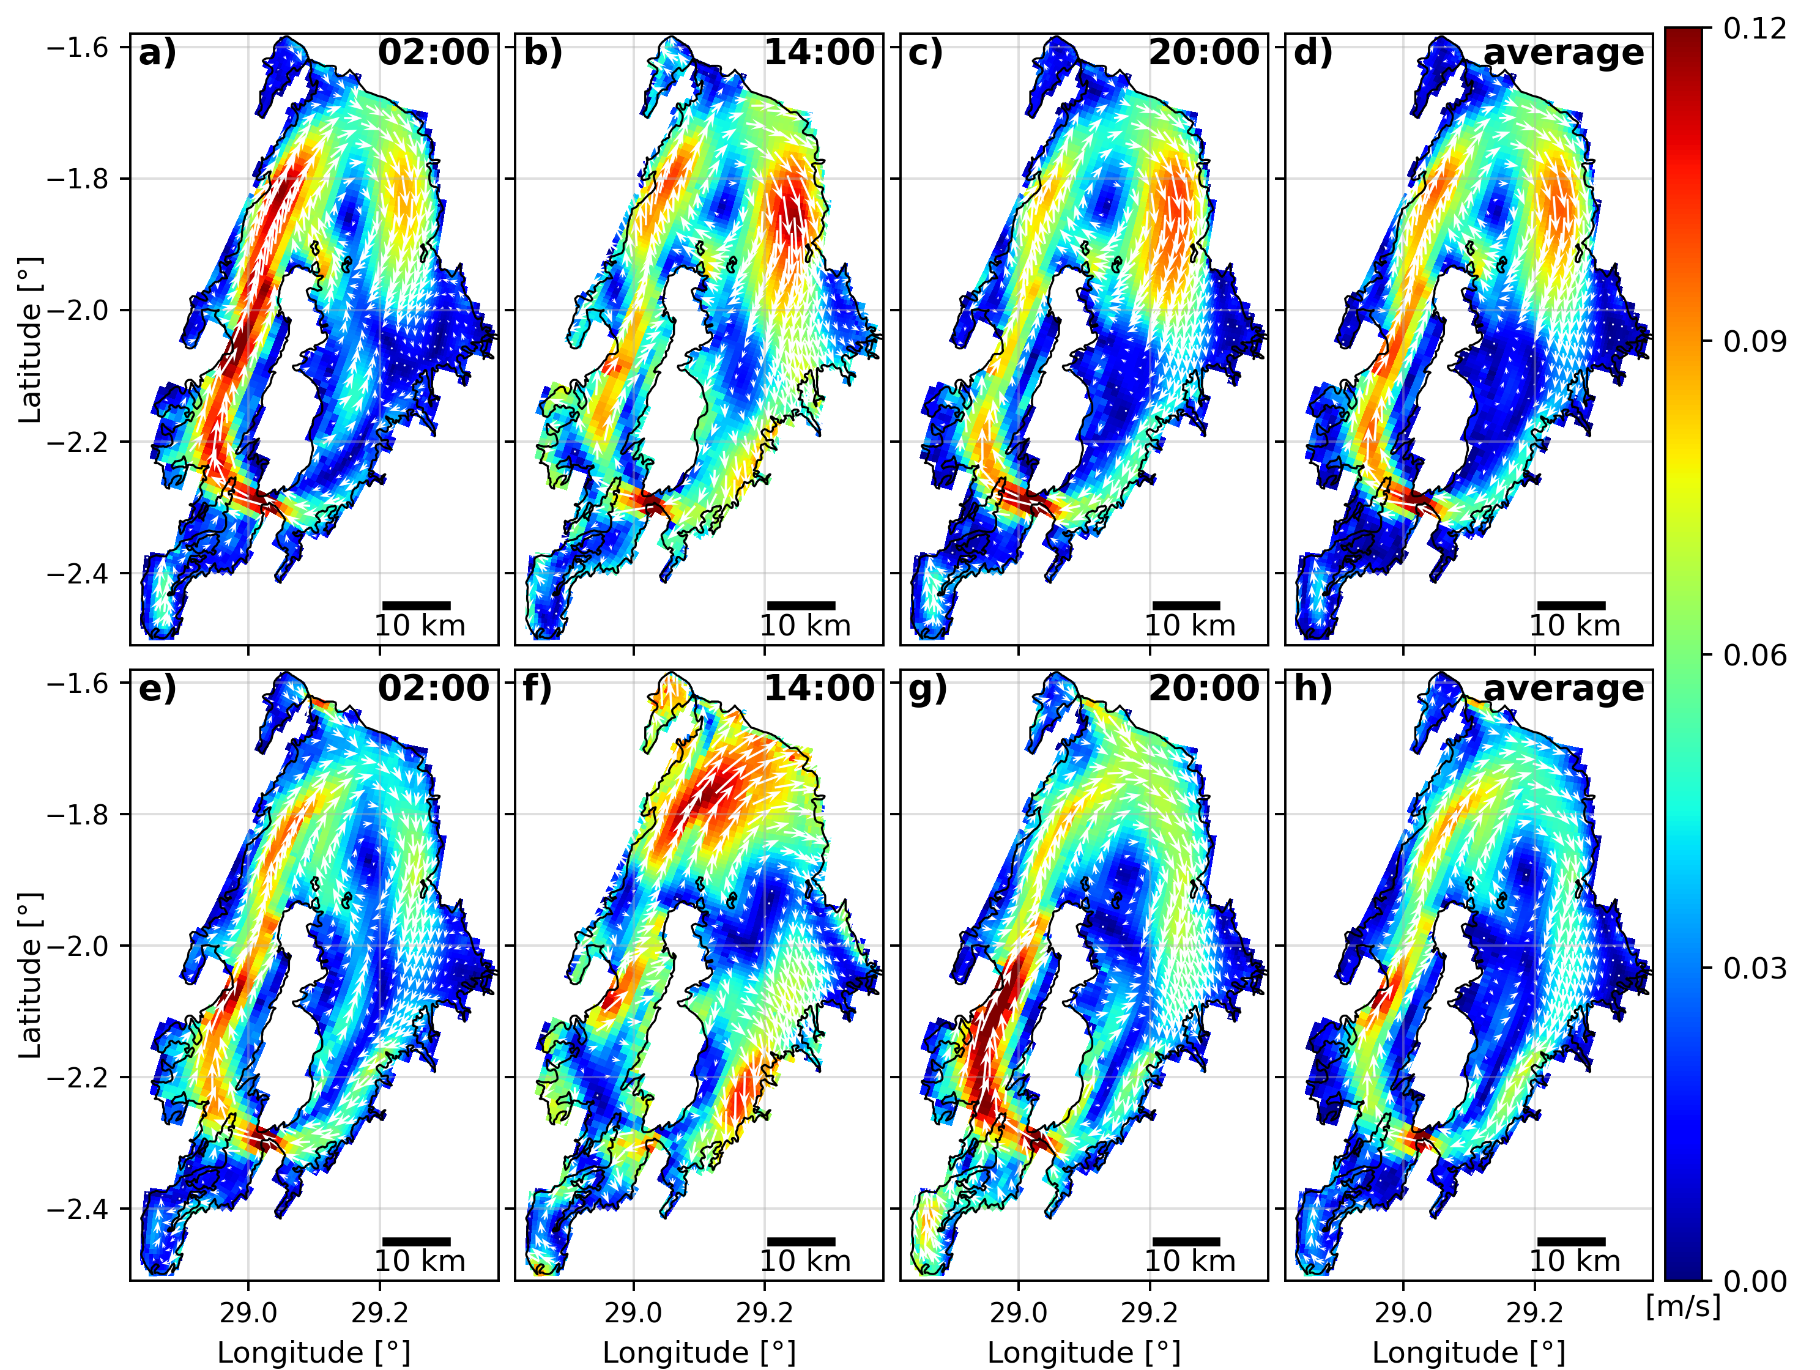
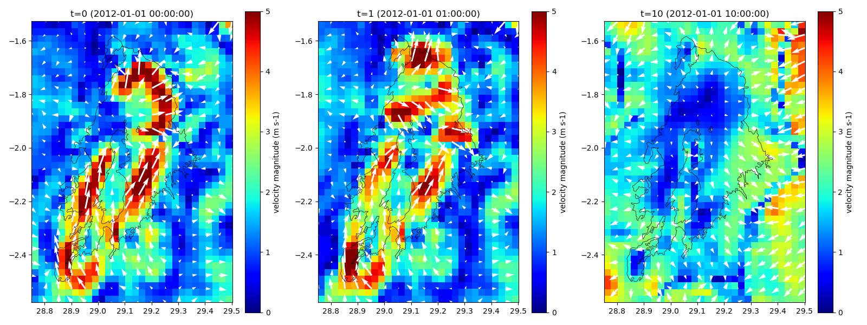
Examples: vector plots for regulargrids
support for any other netCDF
e.g.: SFINCS, Delft3D4, oceanmodels, meteomodels

Slide 16
Next steps
uitbreiding/improvements:
support for D3D4? > overleg met Bert/Isabel
extra models/sources for download/interpolate (evt xESMF for CMCC, climate forcing cmip6 procedure (=calendarconversion) and others)
ini field uit 2D/3D map/rst
gtsm voorbeeld?
monthly/daily means or depth average of his/map fields (to show power of pandas/xarray)
find nearest point in his/map
where/sel voor map (extent masken/croppen), sel werkt nog niet helemaal in xugrid
edge plot (merging edge partitions currently fails, example script beschikbaar)
nesting biesbosch toevoegen: c:\DATA\dfm_tools_testdata\hydrolib_nc\bb_fact2_009a_net.nc
nesting rmm/tcoms (interpolate map to obs/plipoints) (simple wl and z/sigma to z?) (400sec TK?)
nesting FM in FM? (invdist interpolate his to obs/plipoints)
retrieve values on depth w.r.t. z0/wl/bl also in hisfile (now available in mapfile), does it work for rst/fou?

Slide 17
Overlap afstemmen
dfm_tools (Jelmer Veenstra)
hydrolib-core (Arthur van Dam) > is nu dependency
2023 projectplan: mail Arthur 08-12-2022
xugrid (Huite Bootsma) > is nu dependency
DelftDashboard conversie naar Python (Maarten van Ormondt)
hydroMT (Dirk Eilander)
AMO:
tools van coastalhazardsteam (?), coastalhazardstoolkit bevat nog oude fm dingen: https://svn.oss.deltares.nl/repos/openearthtools/trunk/python/applications/coastalhazardstoolkit/
Pieter Koen: bob hoogendoorn notices many githubs/repos/etc
Bob Hoogendoorn: Gert Jan Schotmeijer met een Deltares breed initiatief bezig is voor een toolbox(en).
D-FAST (Bert Jagers), vinden van cellen binnen zekere afstand van een lijn, projecties op een lijn, en doorsnijden van rooster met een lijn. https://iplo.nl/thema/water/applicaties-modellen/watermanagementmodellen/d-fast/
HKV hydamo: https://github.com/openearth/delft3dfmpy >> vervalt binnenkort
paotm hydrodynamica notebooks (wouter) >> inspiratie opdoen en overlap afstemmen: https://github.com/openearth/hydrodynamics-course
C-scale (eg example notebook): https://github.com/c-scale-community/use-case-hisea/blob/main/notebooks/visualise_delft3dfm.ipynb >> bjorn vragen meer hydrolib/dfm_tools te gebruiken (wat heeft hij nog nodig?)

